Slide 1




ARTIFICIAL INTELLIGENCE
Dayananda Sagar University (DSU)- Main Campus
School of Engineering
Devarakaggalahalli, Harohalli Kanakapura Road, Dt, Ramanagara, Karnataka 562112
Department of Computer Science & Engineering
(Artificial Intelligence & Machine Learning)
SEMESTER – IV
Course Code: 23AM2305
22AM2305

Slide 2
Course Learning Objectives
22AM2305
This course will enable students to:
To provide a strong foundation of fundamental concepts in artificial intelligence.
To provide a basic exposition of different types of searching in Artificial intelligence.
To provide different knowledge representation, reasoning, and learning techniques.
To distinguish the different types of expert systems.
To design the Expert System based on the concepts of knowledge representation, searching and Reasoning on various applications using modernised AI tools.

Slide 3
Course Outcome
22AM2305
CO No. | Outcomes | Bloom’s Taxonomy Level
CO1 | Summarize the basic concepts of Artificial Intelligence, AI principles, AI Task domains and applications. | L2
CO2 | Apply the different types of searching and knowledge representations techniques to solve the AI problems. | L3
CO3 | Make use of the different types of reasoning such as Monotonic Reasoning, Non-Monotonic Reasoning and Statistical Reasoning techniques for making analysis and predictions. | L3
CO4 | Differentiate the various types of Experts Systems such as Rule Based, Model Based, Case Based, Hybrid and Fuzzy Expert Systems. | L2
CO5 | Design the Expert System based on the concepts of knowledge representation, searching and Reasoning on various applications using modernised AI tools. | L6

Slide 4
Text Documents Requirement
22AM2305
Textbooks:
Artificial Intelligence, George F Luger, Sixth Edition, Pearson Education Publications, 2014.
Artificial Intelligence, Elaine Rich and Knight, McGraw-Hill Publications, 2010.
Reference Books:
Artificial Intelligence: A modern Approach, Russell and Norvig, Printice Hall, 2010.
Introduction To Artificial Intelligence & Expert Systems, Patterson, PHI.
Multi Agent systems- a modern approach to Distributed Artificial intelligence, Weiss. G, MIT Press.
Artificial Intelligence: A modern Approach, Russell and Norvig, Printice Hall.

Slide 5
Teaching-Learning Process (General Instructions)
22AM2305
These are sample new pedagogical methods that teachers can use to accelerate the attainment of the various course outcomes.
Lecture method means it includes not only the traditional lecture method but a different type of teaching method that may be adopted to develop the course outcomes.
Interactive Teaching: Adopt Active learning that includes brainstorming, discussing, group work, focused listening, formulating questions, note-taking, annotating, and roleplaying.
Show Video/animation films to explain the functioning of various concepts.
Encourage Collaborative (Group Learning) Learning in the class.
To make Critical thinking, ask at least three Higher-order Thinking questions in the class.
Discuss how every concept can be applied to the real world - and when that's possible, it helps improve the student's understanding.

Slide 6
Content of Syllabus
22AM2305
Unit-1 : Introduction | Contact Hours
Introduction: Artificial Intelligence, AI Problems, AI Techniques: supervised learning, unsupervised learning, and reinforcement learning, Different Types of Agents: Simple reflex agents, Model‐based reflex agents, Goal‐based agents and Utility‐based agents; Environment, Problem Space and Search, Defining the Problem as a State Space Search, Problem Characteristics. Textbook 2: Chapter 1,2 | 08
Unit – 2 : Basic Search Techniques
Basic Search Techniques: Solving problems by searching; issues in the design of search programs; uniform search strategies: Breadth first search, Depth first search, Depth limited search, Bidirectional search, Best First search. Textbook 3: Chapter 3, 4; Textbook 2: Chapter 2, 3 | 08

Slide 7
22AM2305
Unit-3 : Special Search Techniques & Knowledge Representation | Contact Hours
Special Search Techniques: Heuristic Search, greedy best first search, A* search, AO*Algorithm, Hill climbing search, Simulated Annealing search, Adversarial search, Minimax search, Alpha, beta pruning, Genetic Algorithm. Knowledge Representation: Procedural Vs Declarative Knowledge, Approaches to Knowledge Representation, Forward Vs Backward Reasoning. Textbook 1: Chapter 5; Textbook 2: Chapter 3, 6 | 08
Unit – 4 : Symbolic Logic, Reasoning & Statistical Reasoning
Symbolic Logic: Propositional Logic, First Order Predicate Logic: Representing Instance and isa Relationships. Reasoning: Introduction to Monotonic Reasoning and Non-Monotonic Reasoning. Statistical Reasoning: Bayes Theorem, Certainty Factors, Bayesian Networks, Dempster-Shafer Theory. Textbook 2: Chapter 7,8 | 07

Slide 8
22AM2305
Unit-5 : Experts Systems | Contact Hours
Experts Systems: Overview of an Expert System, Structure of an Expert Systems, Different Types of Expert Systems: Rule Based, Model Based, Case Based and Hybrid Expert Systems, Knowledge Building System Tools, Expert System Shells and Fuzzy Expert systems. Textbook 1: Chapter 8,9; Textbook 2: Chapter 20,22 | 08
Unit | CO-Mapping
Unit1 | CO1
Unit2 | CO2
Unit3 | CO2
Unit4 | CO3
Unit5 | CO4 & CO5

Slide 9
PEO'S
22AM2305
PEO1. Promote design, research, product implementation and services in the field of Artificial Intelligence Engineering through strong technical, communication and entrepreneurial skills
PEO2. Engage to work productively as design and development Engineers, cater to supportive and leadership roles in multidisciplinary domains.
PEO3. Learn and advance their careers by attaining professional certification and seeking higher education.
PEO4. Possess skill in AI & ML expertise ready to serve the society locally and internationally

Slide 10
PO'S
22AM2305
PO1. Engineering knowledge
PO2. Problem analysis
PO3. Design/development of solutions
PO4. Conduct investigations of complex problems
PO5. Modern tool usage
PO6. The engineer and society
PO7. Environment and sustainability
PO8. Ethics
PO9. Individual and team work
PO10. Communication
PO11. Project management and finance
PO12. Life-long learning

Slide 11
PSO'S
22AM2305
PSO1. Apply the principal concepts of AI Engineering to design, develop, deploy and prototype AI Subsystems
PSO2. Apply the knowledge gained pertaining to data storage, data analytics and AI concepts to solve real world business problems.
PSO3. Apply, analyse, design, develop, and test principles of AI concepts on Intelligent Systems

Slide 12
(Old PSO’S)
22AM2305
Table: Mapping Levels of COs to POs / PSOs
COs | Program Outcomes (POs) |  |  |  |  |  |  |  |  |  |  |  | PSOs
 | Engineering knowledge | Problem analysis | Design/development of solutions | Conduct investigations of complex problems | Modern tool usage | The engineer and society | Environment and sustainability | Ethics | Individual and team work | Communication | Project management and finance | Life-long learning | Apply the principal concepts of AI Engineering to design, develop, deploy and prototype AI Subsystems | Apply the knowledge gained pertaining to data storage, data analytics and AI concepts to solve real world business problems. | Apply, analyse, design, develop, and test principles of AI concepts on Intelligent Systems
CO1 | 2 | - | - | - | 2 | 1 | - | - | 1 | 1 | - | - | 2 | 2 | 2
CO2 | 3 | 2 | - | - | 2 | 1 | - | - | 1 | 1 | - | - | 2 | 2 | 2
CO3 | 3 | 2 | - | - | 2 | 1 | - | - | 1 | 1 | - | - | 2 | 2 | 2
CO4 | 3 | 2 | - | - | 2 | 1 | - | - | 1 | 1 | - | - | 2 | 2 | 2
CO5 | 3 | 3 | 2 | - | 2 | 1 | - | - | 1 | 1 | - | - | 2 | 2 | 2
3: Substantial (High) 2: Moderate (Medium) 1: Poor (Low)

Slide 13
(New PSO’S)
Table: Mapping Levels of COs to POs / PSOs
COs | Program Outcomes (POs) |  |  |  |  |  |  |  |  |  |  |  | PSOs
 | Engineering knowledge | Problem analysis | Design/development of solutions | Conduct investigations of complex problems | Modern tool usage | The engineer and society | Environment and sustainability | Ethics | Individual and team work | Communication | Project management and finance | Life-long learning | Apply Analytical, Mathematical and Programming Skills in AI and ML domain for Design and Development, Analyse and test principles of Intelligent Systems used to solve Real World Problems. | Formulate & Build Optimized Solutions for Computationally Intensive Applications. | PO’s Average
CO1 | 2 | - | - | - | 2 | 1 | - | - | 1 | 1 | - | - | 2 | 2 | 1.40
CO2 | 3 | 2 | - | - | 2 | 1 | - | - | 1 | 1 | - | - | 2 | 2 | 1.66
CO3 | 3 | 2 | - | - | 2 | 1 | - | - | 1 | 1 | - | - | 2 | 2 | 1.66
CO4 | 3 | 2 | - | - | 2 | 1 | - | - | 1 | 1 | - | - | 2 | 2 | 1.66
CO5 | 3 | 3 | 2 | - | 2 | 1 | - | - | 1 | 1 | - | - | 2 | 2 | 1.85
22AM2305
3: Substantial (High) 2: Moderate (Medium) 1: Poor (Low)

Slide 14
22AM2305
E-Resources:
https://onlinecourses.nptel.ac.in/noc22_cs56/preview
https://onlinecourses.nptel.ac.in/noc23_ge40/preview
Activity Based Learning (Suggested Activities in Class)
Flipped Class Activity on Searching Techniques.
Problem Solving and Discussion.
Mini Project (presentation & Report)

Slide 15


Unit 2: Basic Search Techniques
22AM2305
Unit-2 : Basic Search Techniques | Contact Hours
Basic Search Techniques: Solving problems by searching; issues in the design of search programs; uniform search strategies: Breadth first search, Depth first search, Depth limited search, Bidirectional search, Best First search. Textbook 2: Chapter 2, 3 | 08

Slide 16
Basic Search Techniques
22AM2305
Searching is the universal technique of problem-solving in AI. There are some single-player games such as tile games, Sudoku, crossword, etc. The search algorithms help you to search for a particular position in such games.
Search algorithms are important because they solve various problems in artificial intelligence.
There are various search algorithms in AI.

Slide 17

What is a search algorithm?
22AM2305
Search algorithms are algorithms that help in solving search problems.
A search problem consists of a search space, start state, and goal state.
Search algorithms help the AI agents to attain the goal state through the assessment of scenarios and alternatives.
The algorithms provide search solutions through a sequence of actions that transform the initial state to the goal state.

Slide 18
Importance of search algorithms
22AM2305
Solving problems: Search algorithms enhance the solving of problems in artificial intelligence through logical search mechanisms such as problem definition, actions, and search space.
Search programming: Many AI tasks can be programmed in terms of search, which enhances the formulation of the solution to a given problem.
Goal-based agents: Search algorithms enhance the effective operation of goal-based agents. These agents solve problems by searching for the most ideal series of actions that can provide the best solution to a problem.
Support production systems: Search algorithms support the operation of production systems in AI. These are systems that support AI applications through the use of rules and the procedures for implementing them.
Neural network systems: These algorithms are also important in neural network systems. These are computing systems that consist of interconnected nodes, a hidden layer, an input layer, and an output layer. Neural networks are used to perform various tasks in artificial intelligence.

Slide 19
Properties of search algorithms
22AM2305
Completeness: A search algorithm can be said to be complete if it provides a solution for a given input when there exists at least one solution for this input.
Optimality: Search algorithms are also characterized by optimal solutions. These are the best solutions given by the search algorithms at the lowest path cost.
Time Complexity: These algorithms have a maximum time needed to accomplish a task or provide a solution. The time taken is usually based on the complexity of the task.
Space Complexity: They have a maximum memory or storage space needed when conducting a search operation. This memory is also based on the complexity of the task.

Slide 20
How search algorithms work
22AM2305
Artificial intelligence is made possible through AI agents. These agents perform tasks toward achieving a certain goal and establish the actions that can result in the desired goal. The series of these actions provides the solution to the problem.
The AI agents find the best solution for the problem by searching for all the possible alternatives or solutions. The process of searching is done using search algorithms.
Search algorithms work in two main phases: defining the problem and searching in the search space.

Slide 21
Defining the problem
22AM2305
Initial state: This is the start state in which the search starts.
State space: These are all the possible states that can be attained from the initial state through a series of actions.
Actions: These are the steps, activities, or operations undertaken by AI agents in a particular state.
Goal state: This is the endpoint or the desired state.
Goal test: This is a test conducted to establish whether a particular state is a goal state.
Path cost: This is the cost associated with a given path taken by the agents.

Slide 22
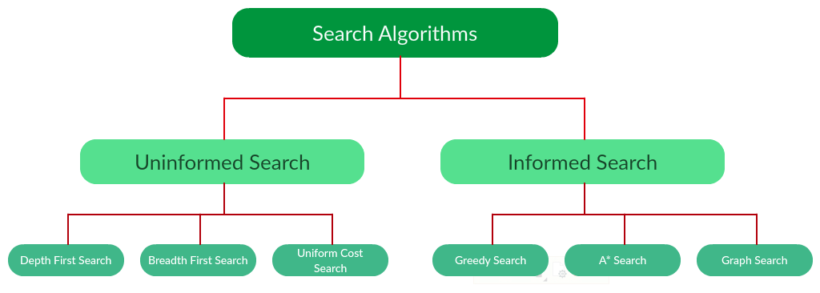
Types of search algorithms:
22AM2305

Slide 23

Informed Search
22AM2305
They contain information on goal state.
It helps search efficiently.
The information is obtained by a function that helps estimate how close a current state is, to the goal state.
Examples of informed search include greedy search and graph search.
It uses the knowledge in the process of searching.
It helps find the solution quickly.
It may or may not be complete.
It is inexpensive.
It consumes less time.
It gives the direction about the solution.
It is less lengthy to implement.

Slide 24
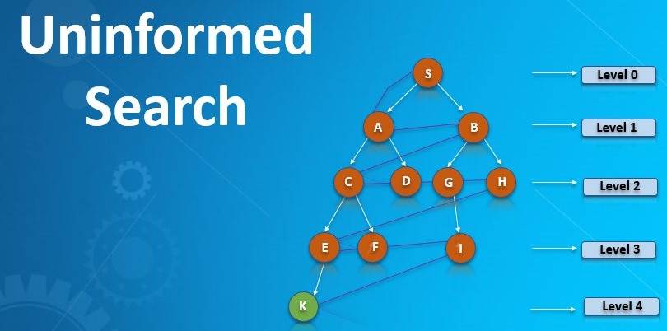
Uninformed Search
22AM2305
They don’t have any additional information.
The information is only provided in the problem definition.
The goal state can be reached using different order and length of actions.
Examples of uninformed search include depth first search (DFS) and breadth first search (BFS).
It doesn’t use the knowledge in the process of searching.
It takes more time to show the solution.
It is always complete.
It is expensive.
It consumes moderate time.
There is no suggestion regarding finding the solution.
It is lengthy to implement.

Slide 25

22AM2305

Slide 26
22AM2305
Parameters | Informed Search | Uninformed Search
Known as | It is also known as Heuristic Search. | It is also known as Blind Search.
Using Knowledge | It uses knowledge for the searching process. | It doesn’t use knowledge for the searching process.
Performance | It finds a solution more quickly. | It finds solution slow as compared to an informed search.
Completion | It may or may not be complete. | It is always complete.
Cost Factor | Cost is low. | Cost is high.
Time | It consumes less time because of quick searching. | It consumes moderate time because of slow searching.
Direction | There is a direction given about the solution. | No suggestion is given regarding the solution in it.

Slide 27
22AM2305
Parameters | Informed Search | Uninformed Search
Implementation | It is less lengthy while implemented. | It is more lengthy while implemented.
Efficiency | It is more efficient as efficiency takes into account cost and performance. The incurred cost is less and speed of finding solutions is quick. | It is comparatively less efficient as incurred cost is more and the speed of finding the Breadth-Firstsolution is slow.
Computational requirements | Computational requirements are lessened. | Comparatively higher computational requirements.
Size of search problems | Having a wide scope in terms of handling large search problems. | Solving a massive search task is challenging.
Examples of Algorithms | Greedy Search A* Search AO* Search Hill Climbing Algorithm | Depth First Search (DFS) Breadth First Search (BFS) Branch and Bound

Slide 28
Uniformed/Blind Search
22AM2305
The uninformed search does not contain any domain knowledge such as closeness, the location of the goal.
It operates in a brute-force way as it only includes information about how to traverse the tree and how to identify leaf and goal nodes.
Uninformed search applies a way in which search tree is searched without any information about the search space like initial state operators and test for the goal, so it is also called blind search.
It examines each node of the tree until it achieves the goal node.
Uninformed search is a class of general-purpose search algorithms which operates in brute force-way.
Uninformed search algorithms do not have additional information about state or search space other than how to traverse the tree, so it is also called blind search.

Slide 29
Uniformed/Blind Search Divided into five main types
22AM2305
Breadth first search
Depth first search
Depth limited search
Bidirectional search
Best First search

Slide 30
Breadth-first Search (BFS)
22AM2305
Breadth-first search is the most common search strategy for traversing a tree or graph. This algorithm searches breadthwise in a tree or graph, so it is called breadth-first search.
BFS algorithm starts searching from the root node of the tree and expands all successor node at the current level before moving to nodes of next level.
The breadth-first search algorithm is an example of a general-graph search algorithm.
Breadth-first search implemented using FIFO queue data structure.

Slide 31
22AM2305
Advantages:
BFS will provide a solution if any solution exists.
If there are more than one solution for a given problem, then BFS will provide the minimal solution which requires the least number of steps.
Disadvantages:
It requires lots of memory since each level of the tree must be saved into memory to expand the next level.
BFS needs lots of time if the solution is far away from the root node.

Slide 32
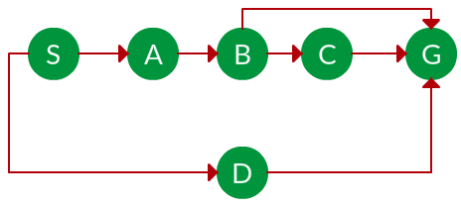
22AM2305
Example: Question. Which solution would BFS find to move from node S to node G if run on the graph below?

Slide 33
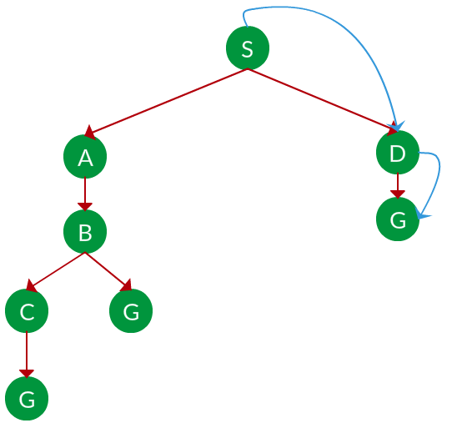
22AM2305
Solution. The equivalent search tree for the above graph is as follows. As BFS traverses the tree “shallowest node first”, it would always pick the shallower branch until it reaches the solution (or it runs out of nodes, and goes to the next branch). The traversal is shown in blue arrows.
Path: S -> D -> G

Slide 34
22AM2305
s = the depth of the shallowest solution.
ni= number of nodes in level i.
Time complexity: Equivalent to the number of nodes traversed in BFS until the shallowest solution.
Space complexity: Equivalent to how large can the fringe get. Completeness: BFS is complete, meaning for a given search tree, BFS will come up with a solution if it exists.
Optimality: BFS is optimal as long as the costs of all edges are equal.

Slide 35
22AM2305
Uniform Cost Search:
UCS is different from BFS and DFS because here the costs come into play. In other words, traversing via different edges might not have the same cost. The goal is to find a path where the cumulative sum of costs is the least.
Cost of a node is defined as:
cost(node) = cumulative cost of all nodes from root
cost(root) = 0

Slide 36
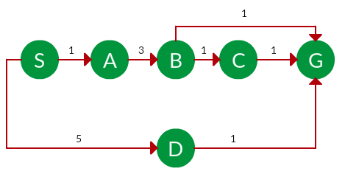
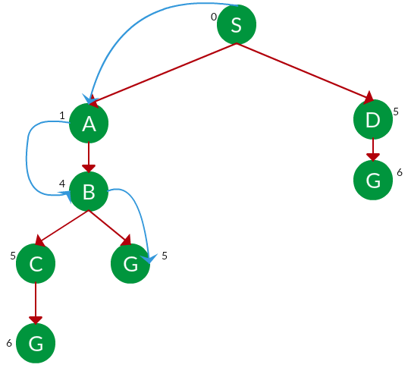
22AM2305
Example:
Question. Which solution would UCS find to move from node S to node G if run on the graph below?
https://www.hackerearth.com/practice/algorithms/graphs/breadth-first-search/tutorial/

Slide 37
22AM2305
Solution. The equivalent search tree for the above graph is as follows. The cost of each node is the cumulative cost of reaching that node from the root. Based on the UCS strategy, the path with the least cumulative cost is chosen. Note that due to the many options in the fringe, the algorithm explores most of them so long as their cost is low, and discards them when a lower-cost path is found; these discarded traversals are not shown below. The actual traversal is shown in blue.
Path: S -> A -> B -> G Cost: 5
Let C = cost of solution. ε = arcs cost.
Then c/ ε effective depth
Time complexity: , Space Complexity

Slide 38
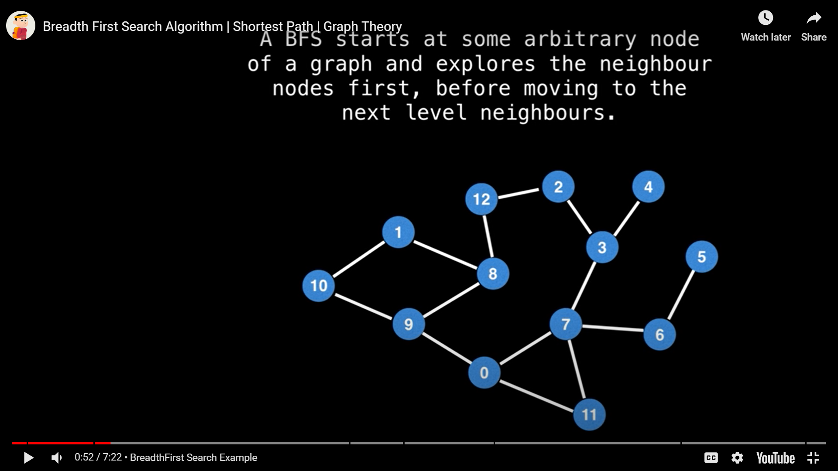
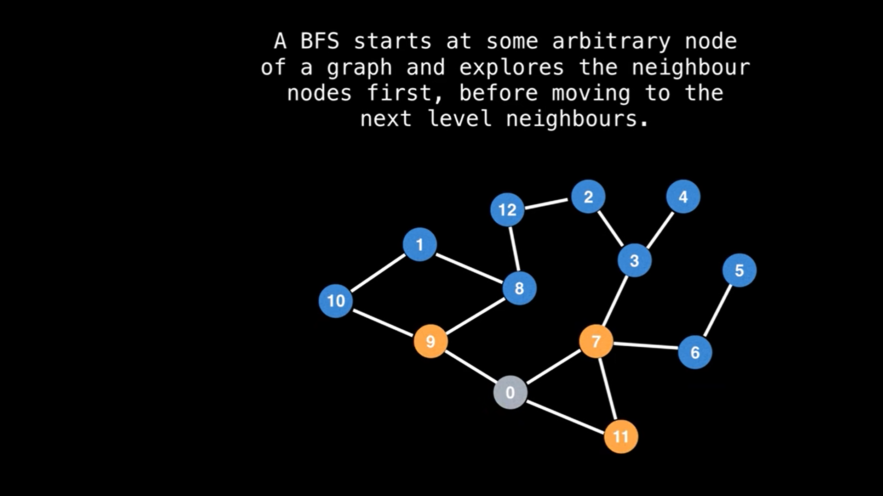
22AM2305

Slide 39
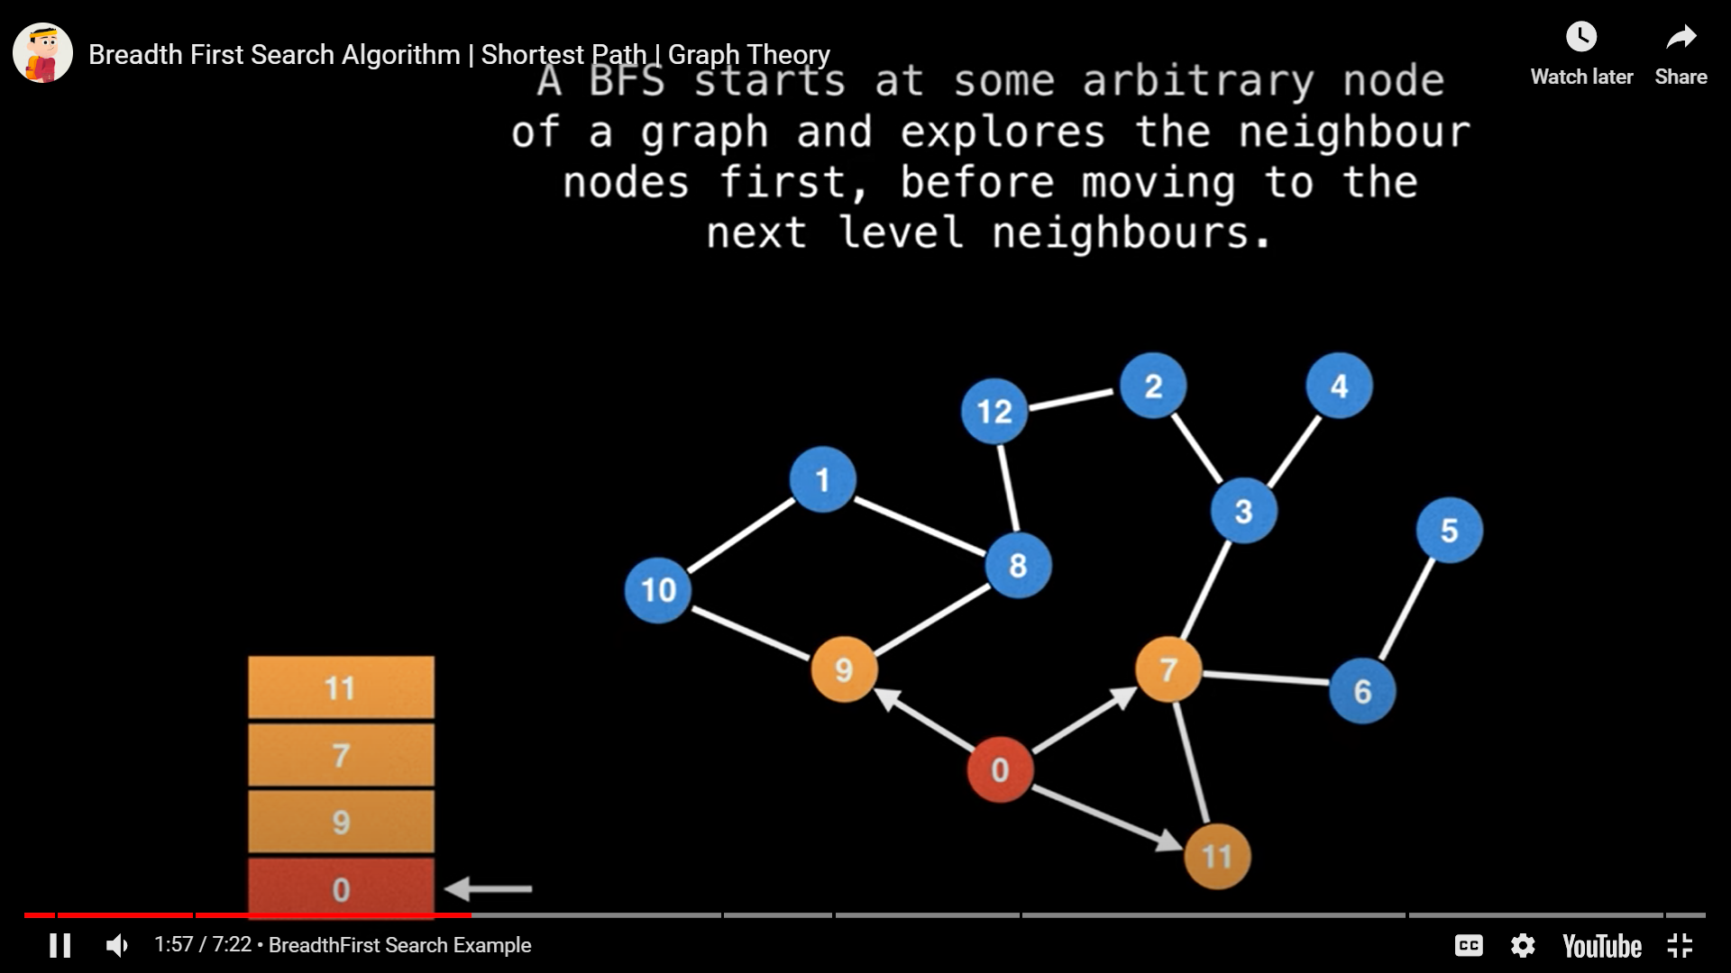
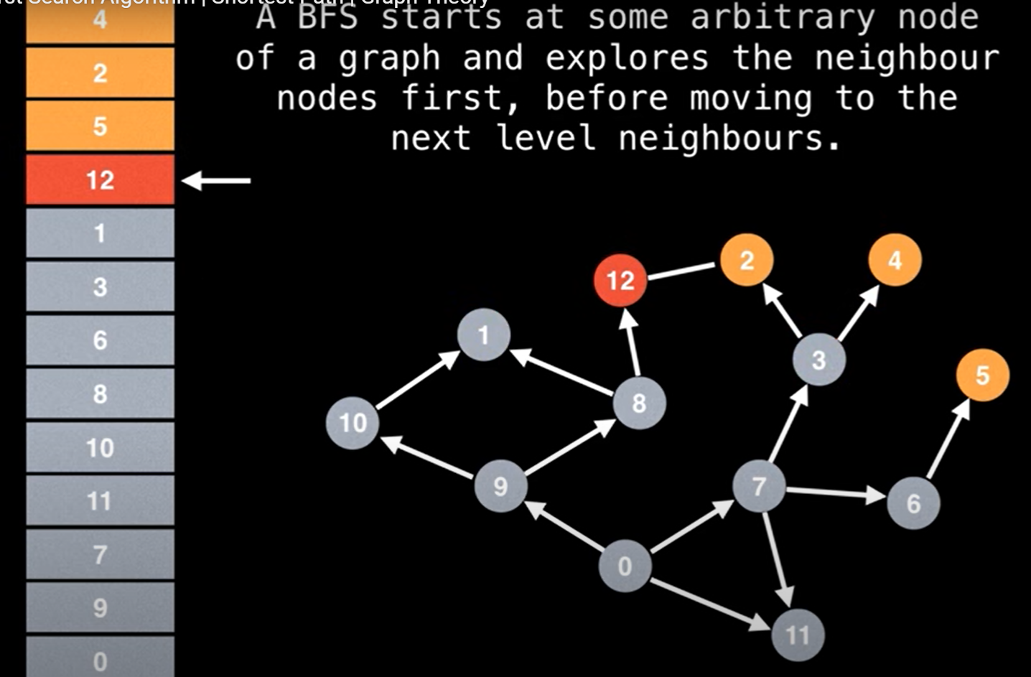
22AM2305

Slide 40
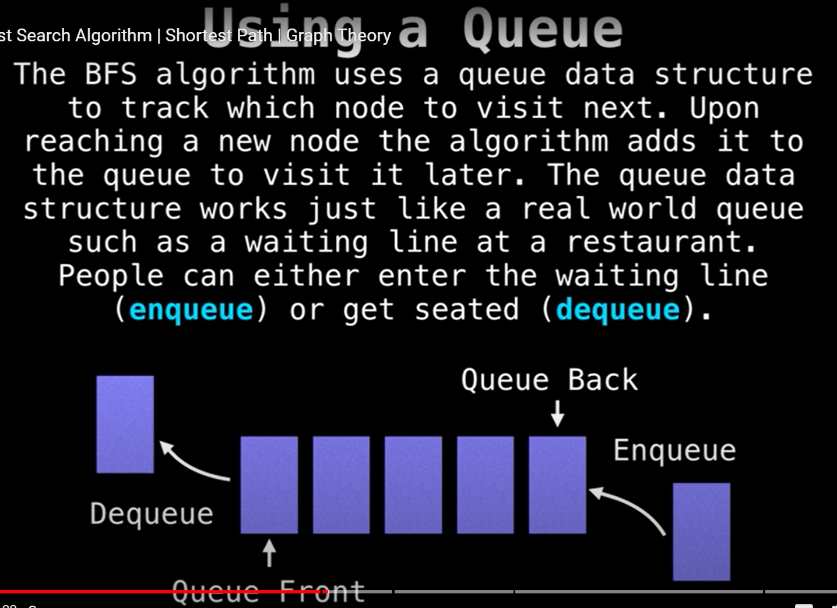
22AM2305
https://www.google.com/search?q=complete+information+on+breadth+first+search+(bfs)&rlz=1C1UEAD_enIN1034IN1034&oq=complete+information+on+breadth&gs_lcrp=EgZjaHJvbWUqBwgCECEYoAEyBggAEEUYOTIHCAEQIRigATIHCAIQIRigATIHCAMQIRiPAjIHCAQQIRiPAtIBCTIzMjM4ajFqN6gCALACAA&sourceid=chrome&ie=UTF-8#fpstate=ive&vld=cid:31d63990,vid:oDqjPvD54Ss,st:0

Slide 41
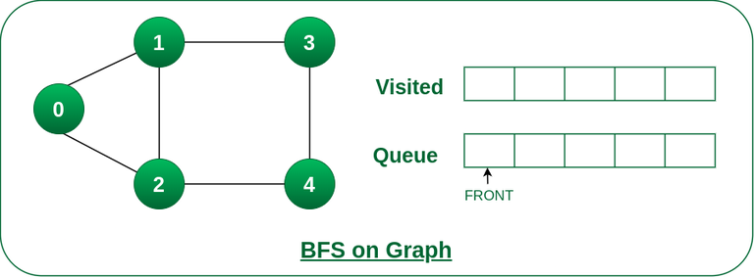
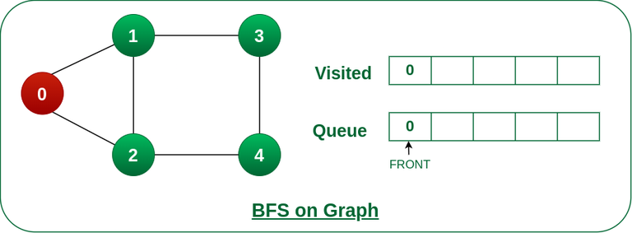
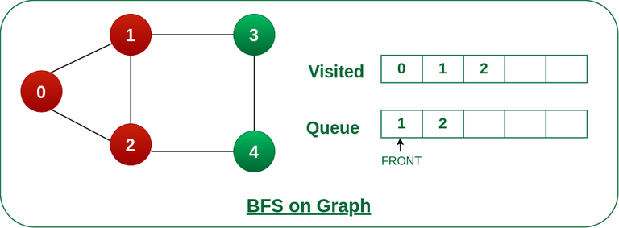
How does BFS work?
22AM2305

Slide 42
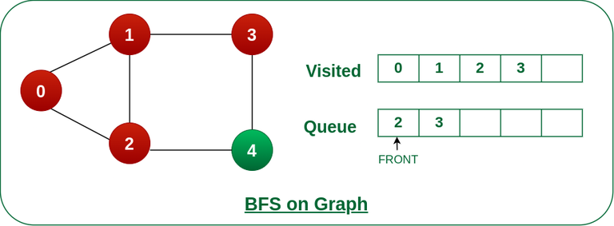
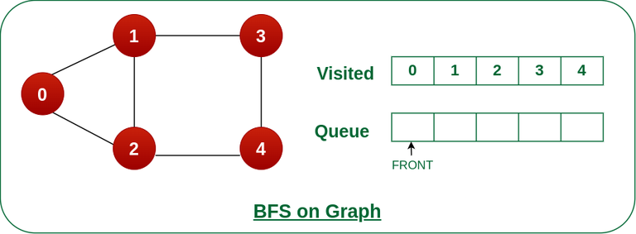


How does BFS work?
22AM2305

Slide 43
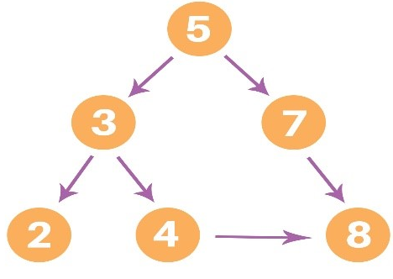
BFS implementation
22AM2305
BFS pseudocode
The pseudocode for BFS in python goes as below:
create a queue Q
mark v as visited and put v into Q
while Q is non-empty
remove the head u of Q
mark and enqueue all (unvisited) neighbors of u

Slide 44
BFS implementation
22AM2305
graph = {
'5' : ['3','7'],
'3' : ['2', '4'],
'7' : ['8'],
'2' : [],
'4' : ['8'],
'8' : []
}
visited = [] # List for visited nodes.
queue = [] #Initialize a queue
def bfs(visited, graph, node): #function for BFS
visited.append(node)
queue.append(node)
while queue: # Creating loop to visit each node
m = queue.pop(0)
print (m, end = " ")
for neighbour in graph[m]:
if neighbour not in visited:
visited.append(neighbour)
queue.append(neighbour)
# Driver Code
print("Following is the Breadth-First Search")
bfs(visited, graph, '5') # function calling
Following is the Breadth-First Search
5 3 7 2 4 8

Slide 45
Depth first search
22AM2305
Depth-first search is a recursive algorithm for traversing a tree or graph data structure.
It is called the depth-first search because it starts from the root node and follows each path to its greatest depth node before moving to the next path.
Depth = vertical before horizontal.
DFS uses a stack data structure for its implementation.
The process of the DFS algorithm is similar to the BFS algorithm.
Advantage:
DFS requires much less memory as it only needs to store a stack of the nodes on the path from root node to the current node.
It takes less time to reach the goal node than the BFS algorithm (if it traverses in the right path).
Disadvantage:
There is the possibility that many states keep re-occurring, and there is no guarantee of finding a solution.
DFS algorithm goes for deep-down searching; sometimes it may go to the infinite loop.

Slide 46
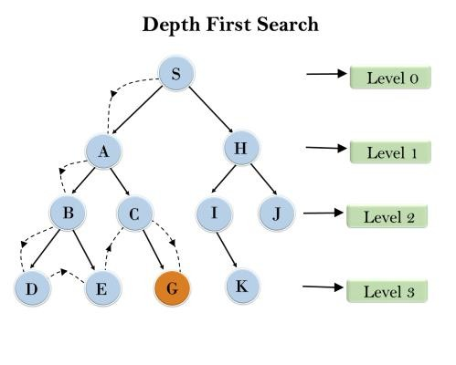
22AM2305
In the below search tree, we have shown the flow of depth-first search, and it will follow the order as:
Root node--->Left node ----> right node.
It will start searching from root node S, and traverse A, then B, then D and E, after traversing E, it will backtrack the tree as E has no other successor and still goal node is not found. After backtracking it will traverse node C and then G, and here it will terminate as it found goal node.

Slide 47
22AM2305
T(n)= 1+ n²+ n³ +.........+ n^{m}=O(n^{m})
Where, m= maximum depth of any node and this can be much larger than d (Shallowest solution depth)
Space Complexity: DFS algorithm needs to store only single path from the root node, hence space complexity of DFS is equivalent to the size of the fringe set, which is O(bm).
Optimal: DFS search algorithm is non-optimal, as it may generate a large number of steps or high cost to reach to the goal node.

Slide 48
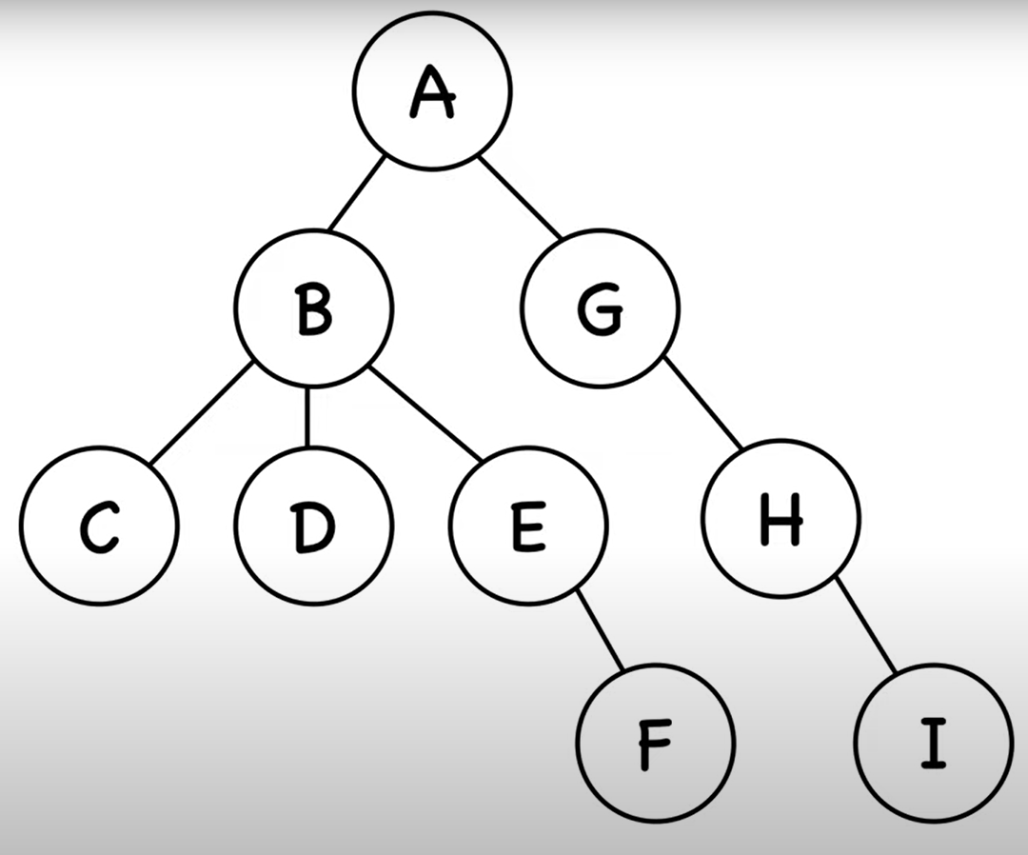
22AM2305

Slide 49
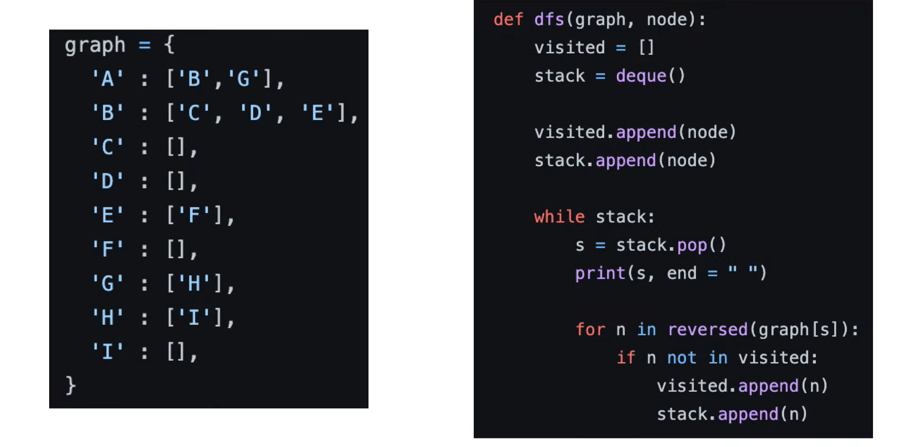
22AM2305

Slide 50
Example on DFS
22AM2305

Slide 51
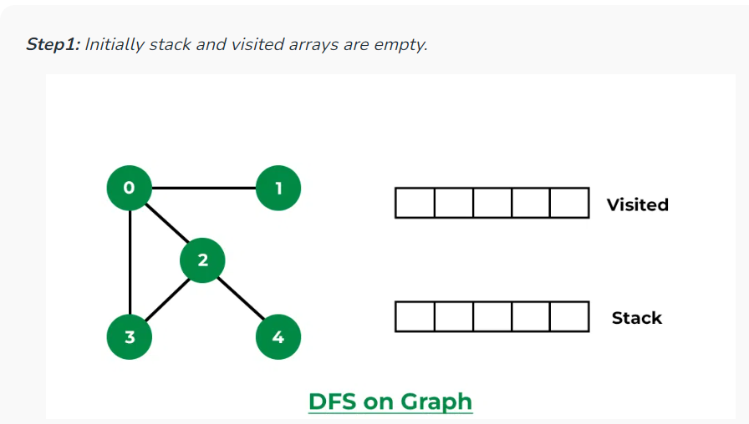
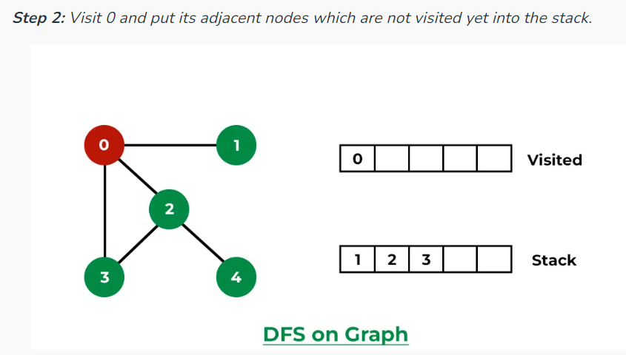
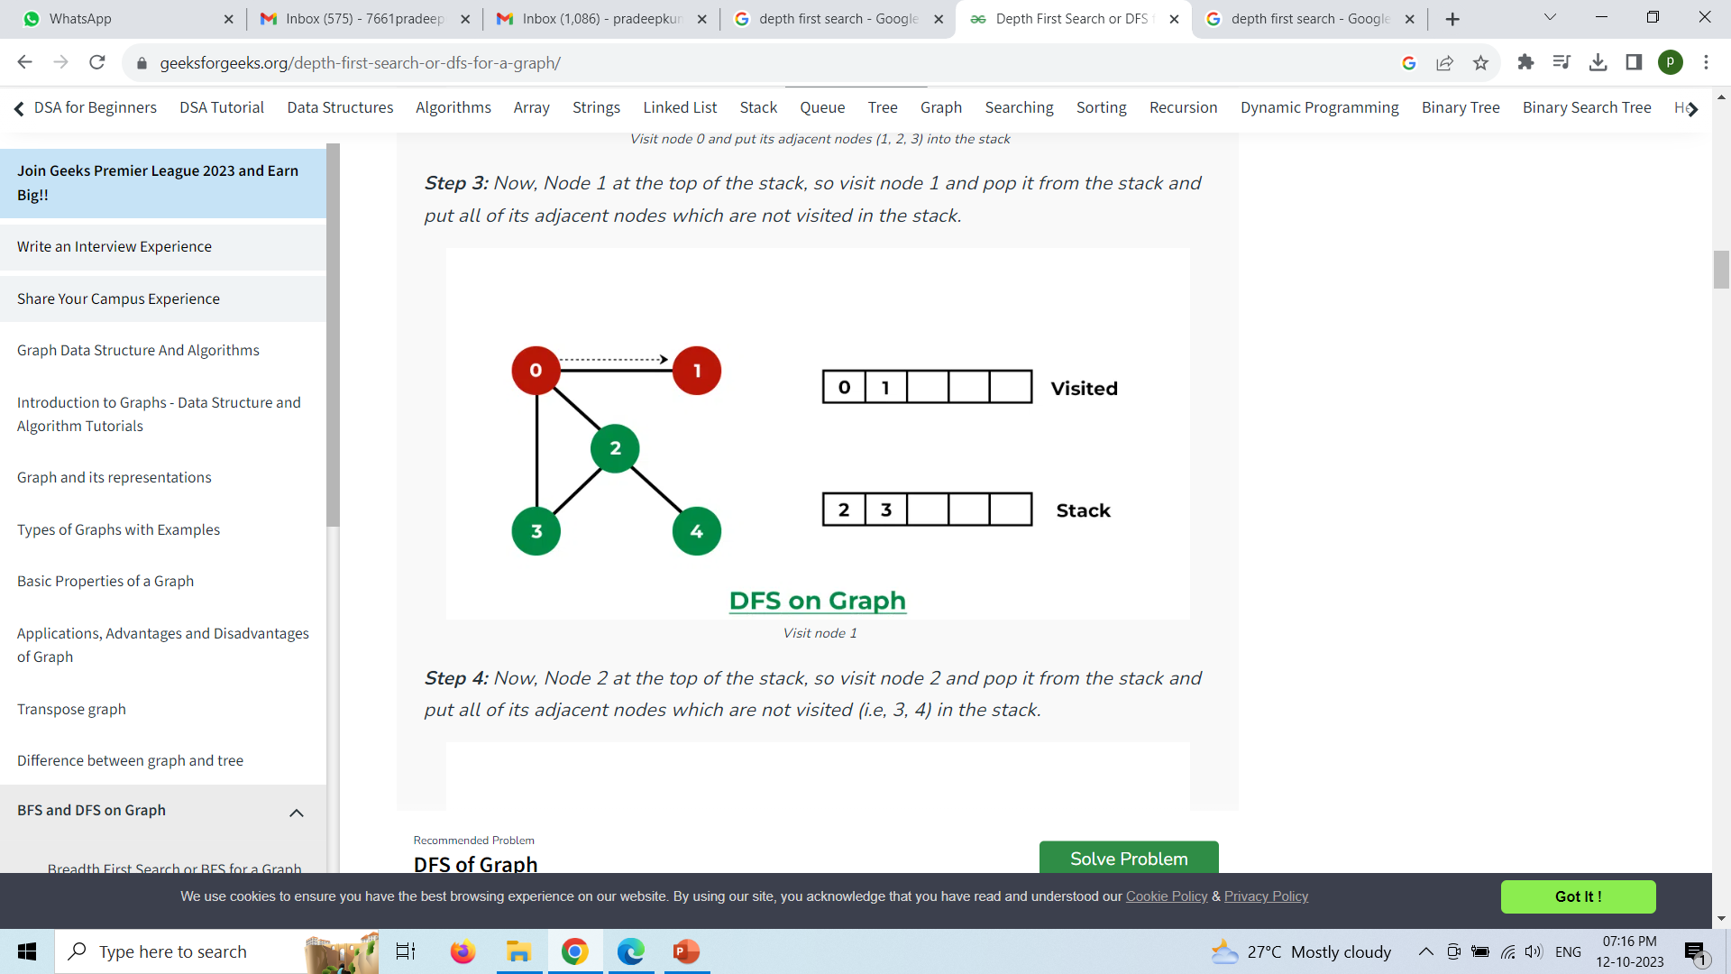
22AM2305

Slide 52
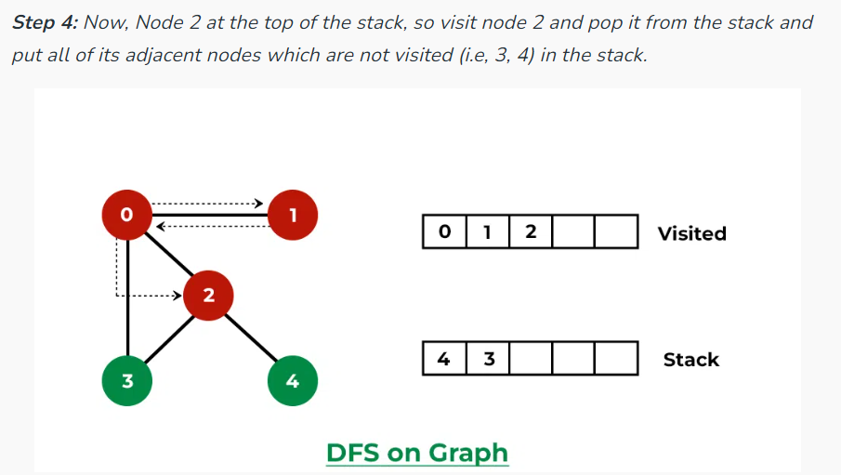
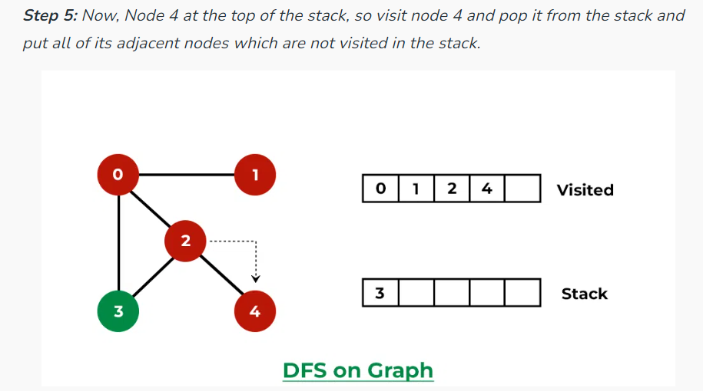
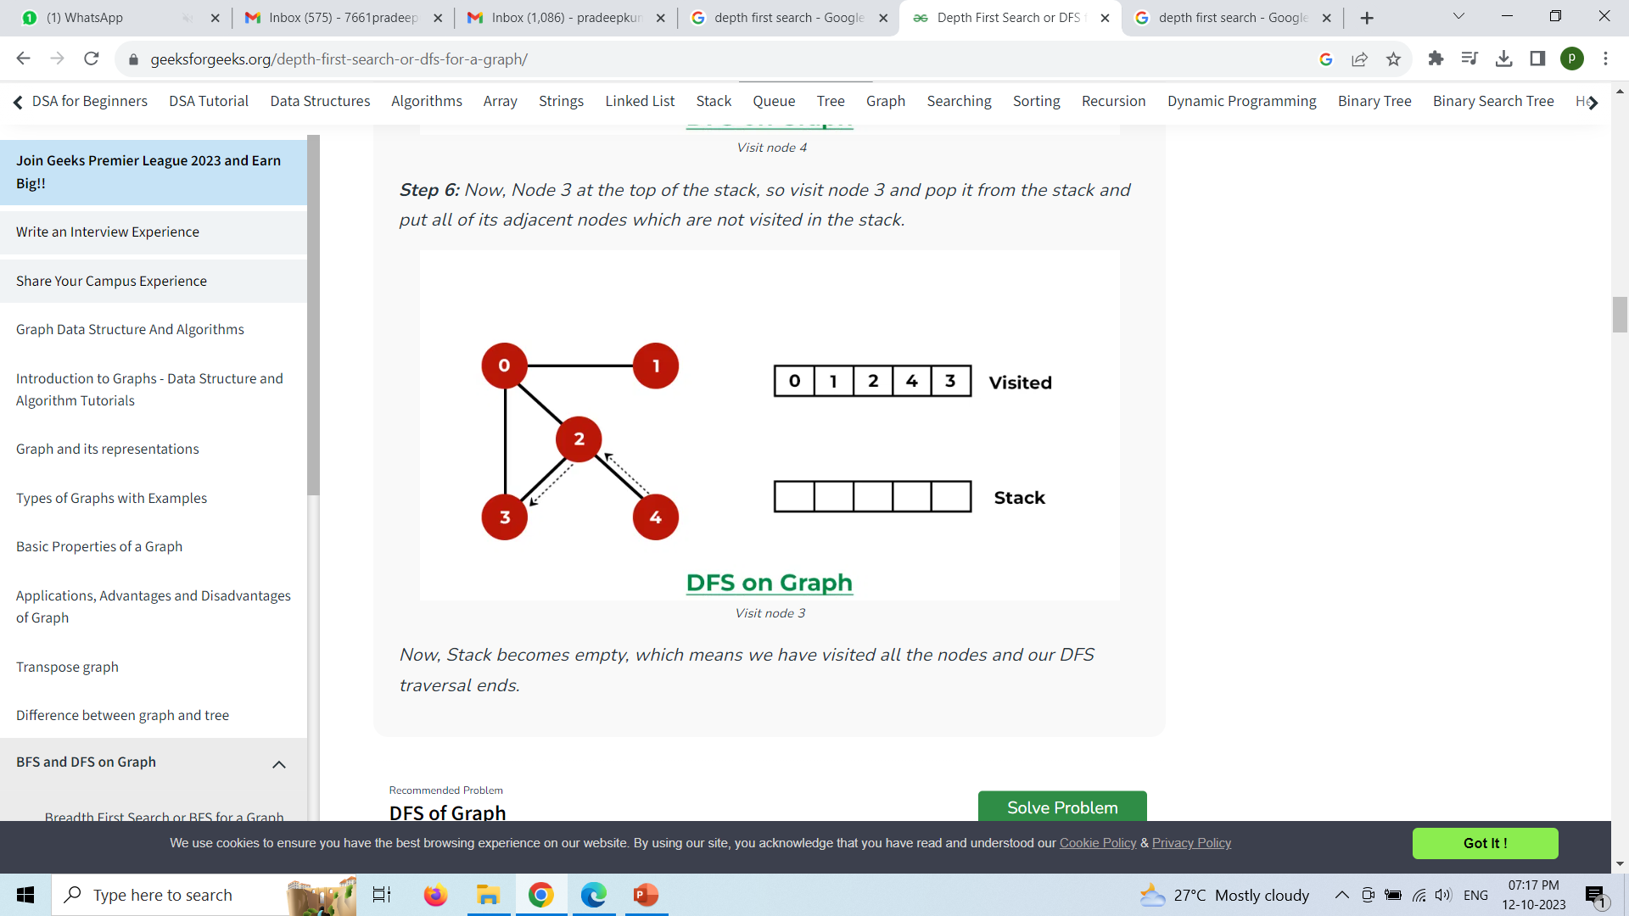
22AM2305

Slide 53

22AM2305
Following is the Depth-First Search
5
3
2
4
8
7
# Using a Python dictionary to act as an #adjacency list
graph = {
'5' : ['3','7'],
'3' : ['2', '4'],
'7' : ['8'],
'2' : [],
'4' : ['8'],
'8' : []
}
visited = set() # Set to keep track of #visited nodes of graph.
def dfs(visited, graph, node): #function for dfs
if node not in visited:
print (node)
visited.add(node)
for neighbour in graph[node]:
dfs(visited, graph, neighbour)
# Driver Code
print("Following is the Depth-First Search")
dfs(visited, graph, '5')

Slide 54
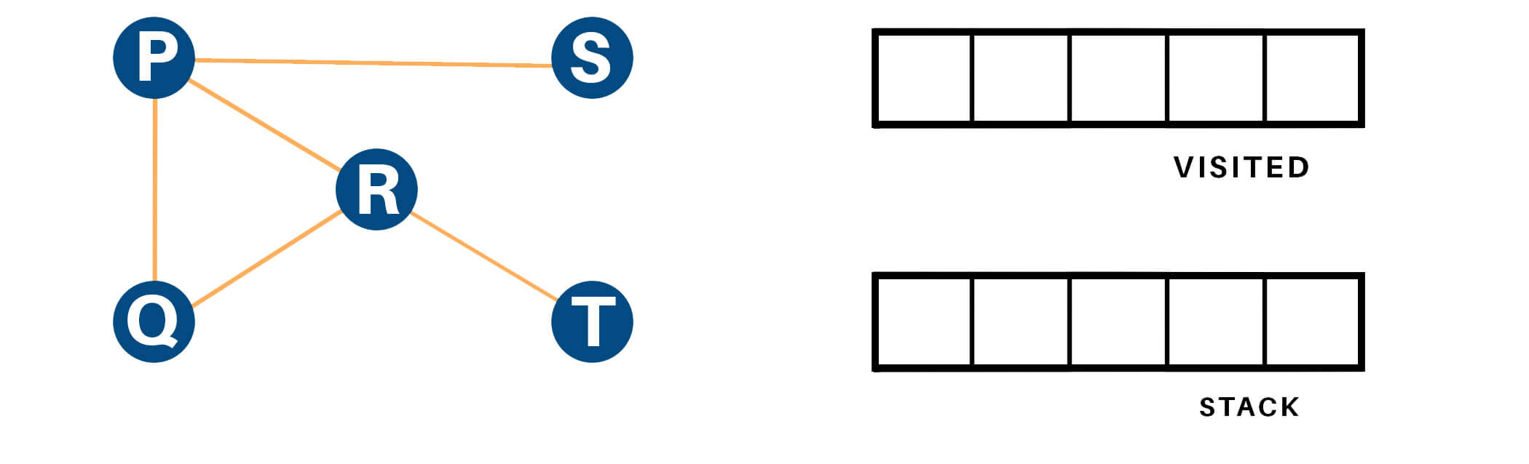
22AM2305
Example
Let us see how the DFS algorithm works with an example. Here, we will use an undirected graph with 5 vertices.

Slide 55
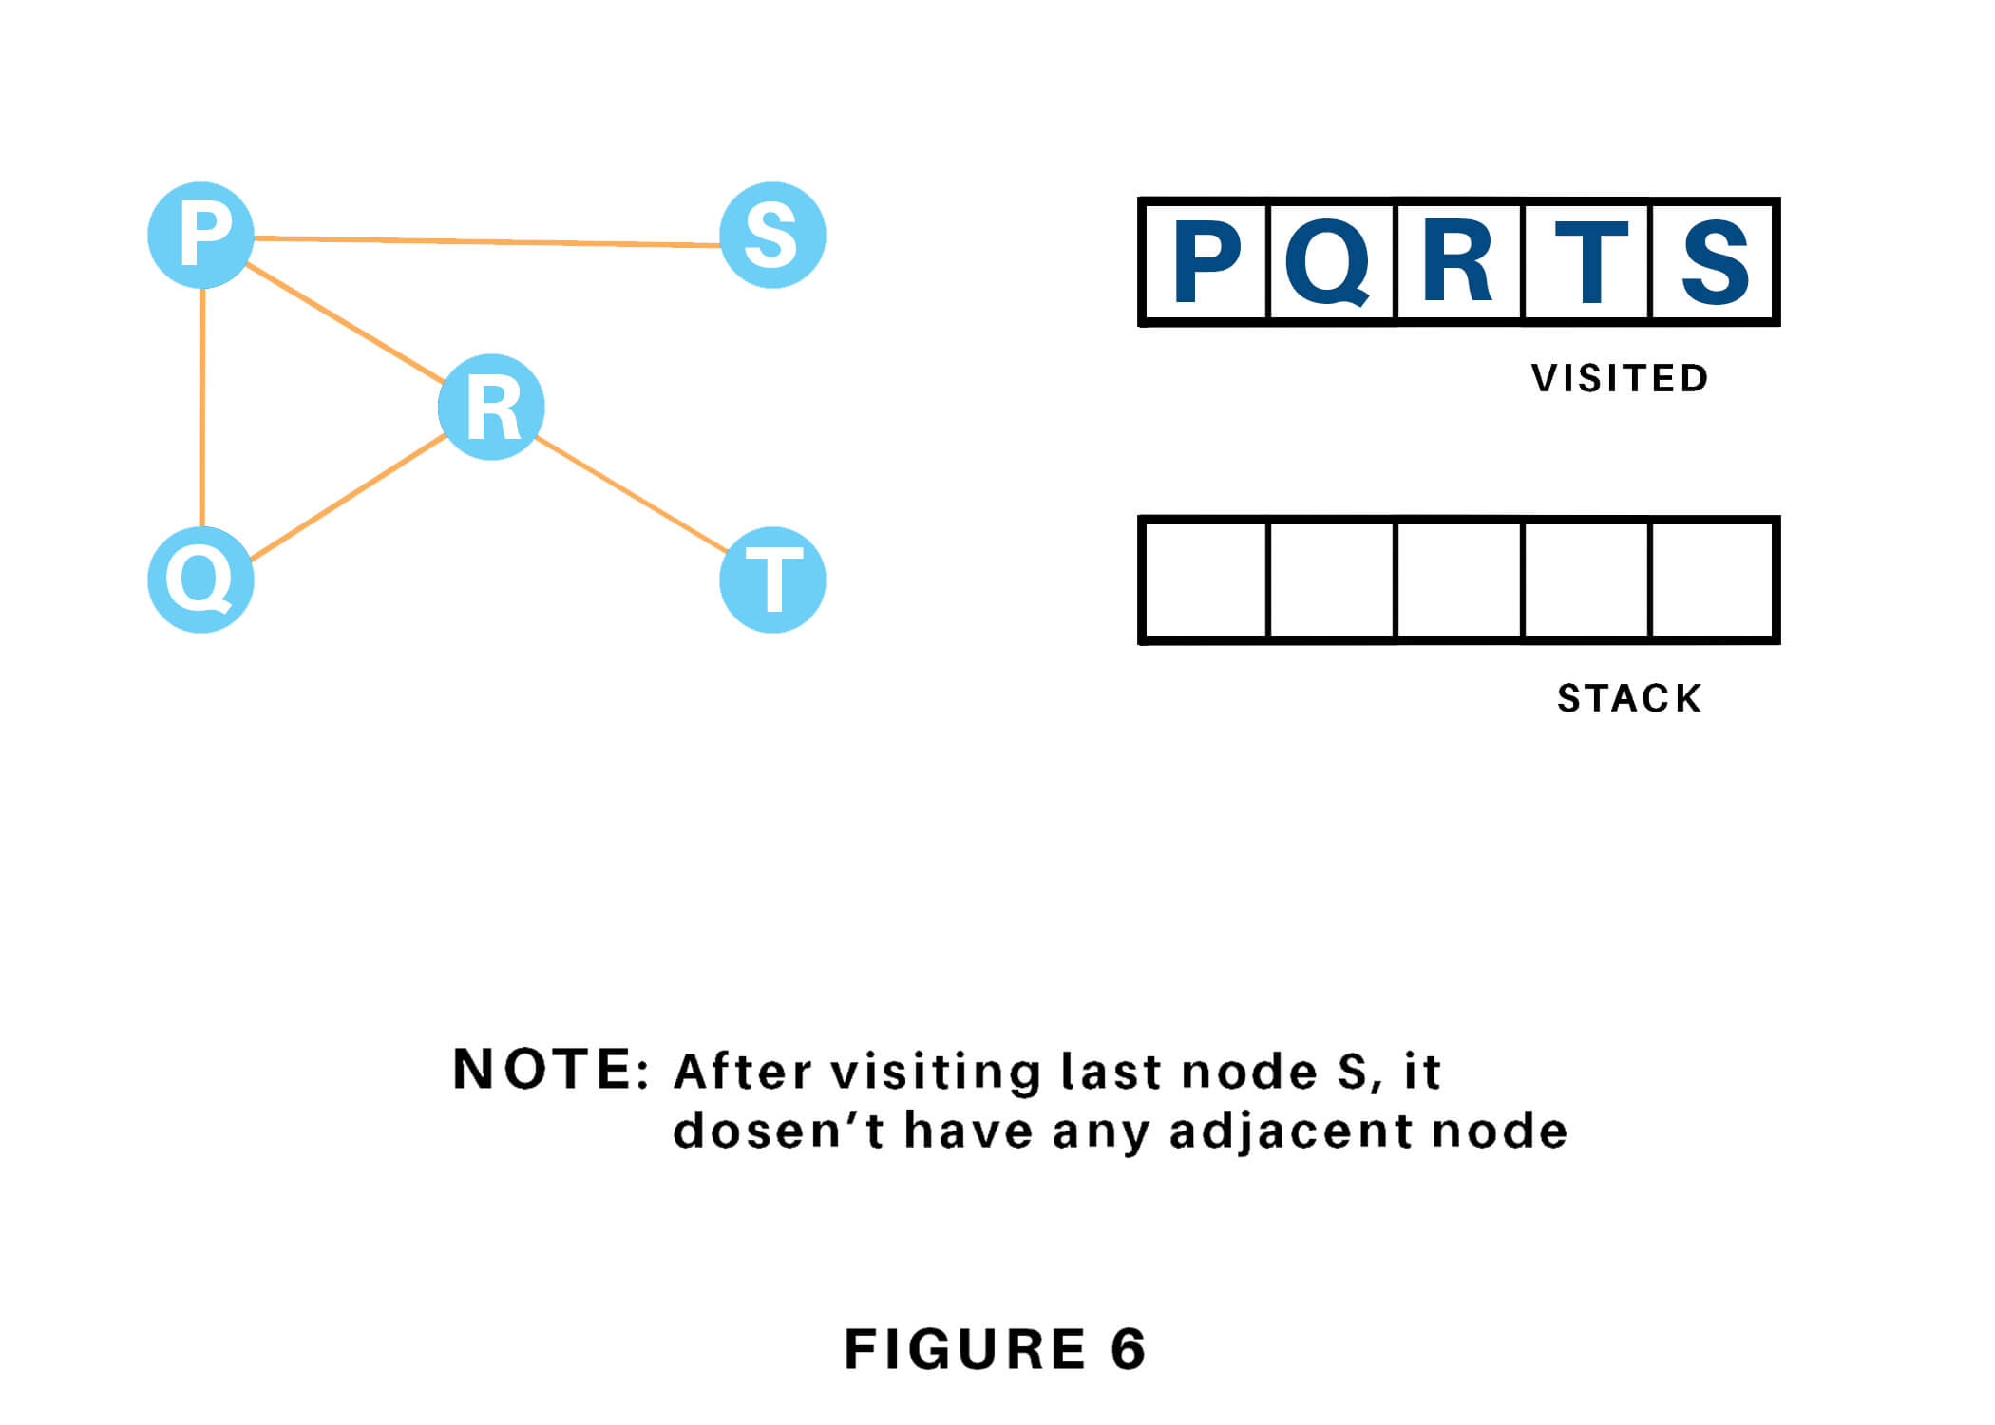
22AM2305
Solution

Slide 56
Applications
22AM2305
Depth-First Search Algorithm has a wide range of applications for practical purposes. Some of them are discussed below:
For finding the strongly connected components of the graph
To find the path
To test if the graph is bipartite
For detecting cycles in a graph
Topological Sorting
Solving the puzzle with only one solution.
Network Analysis
Mapping Routes
Scheduling a problem

Slide 57
Depth limited search
22AM2305
A depth-limited search algorithm is similar to depth-first search with a predetermined limit. Depth-limited search can solve the drawback of the infinite path in the Depth-first search. In this algorithm, the node at the depth limit will treat as it has no successor nodes further.
Depth-limited search can be terminated with two Conditions of failure:
Standard failure value: It indicates that problem does not have any solution.
Cutoff failure value: It defines no solution for the problem within a given depth limit.
Advantages:
Depth-limited search is Memory efficient.
Disadvantages:
Depth-limited search also has a disadvantage of incompleteness.
It may not be optimal if the problem has more than one solution.

Slide 58
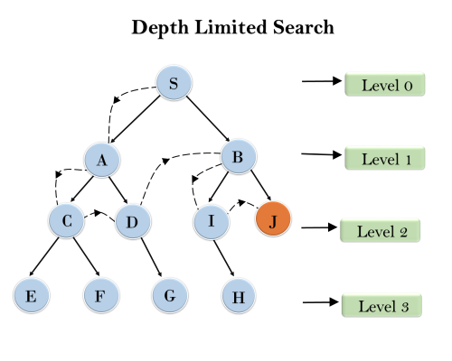
22AM2305
Completeness: DLS search algorithm is complete if the solution is above the depth-limit.
Time Complexity: Time complexity of DLS algorithm is O(b^{ℓ}).
Space Complexity: Space complexity of DLS algorithm is O(b×ℓ).
https://www.youtube.com/watch?v=SoJxjJmA9rs

Slide 59
Bidirectional search
22AM2305
Bidirectional search algorithm runs two simultaneous searches, one from initial state called as forward-search and other from goal node called as backward-search, to find the goal node. Bidirectional search replaces one single search graph with two small subgraphs in which one starts the search from an initial vertex and other starts from goal vertex. The search stops when these two graphs intersect each other.
Bidirectional search can use search techniques such as BFS, DFS, DLS, etc.
Advantages:
Bidirectional search is fast.
Bidirectional search requires less memory.
Disadvantages:
Implementation of the bidirectional search tree is difficult.
In bidirectional search, one should know the goal state in advance.

Slide 60
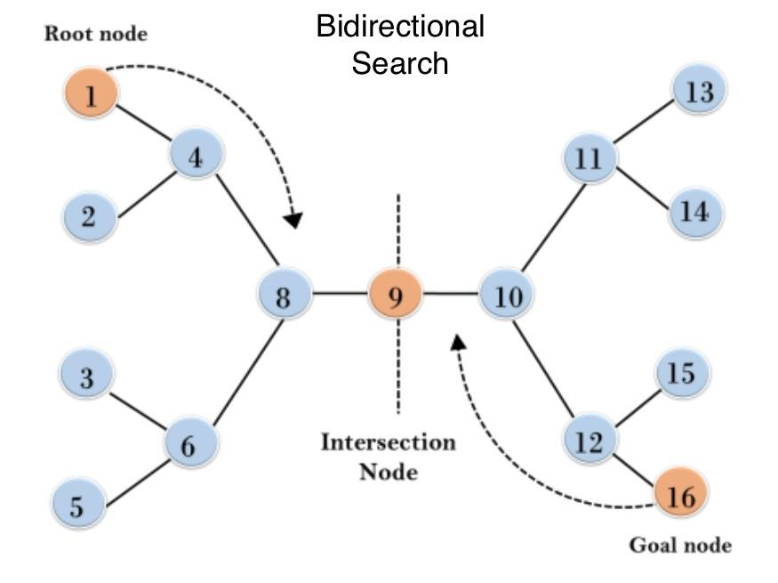
22AM2305
In the below search tree, bidirectional search algorithm is applied. This algorithm divides one graph/tree into two sub-graphs. It starts traversing from node 1 in the forward direction and starts from goal node 16 in the backward direction.
The algorithm terminates at node 9 where two searches meet.
Completeness: Bidirectional Search is complete if we use BFS in both searches.
Time Complexity: Time complexity of bidirectional search using BFS is O(b^{d}).
Space Complexity: Space complexity of bidirectional search is O(b^{d}).
Optimal: Bidirectional search is Optimal.

Slide 61
Best First search
22AM2305
Greedy best-first search algorithm always selects the path which appears best at that moment. It is the combination of depth-first search and breadth-first search algorithms. It uses the heuristic function and search. Best-first search allows us to take the advantages of both algorithms. With the help of best-first search, at each step, we can choose the most promising node. In the best first search algorithm, we expand the node which is closest to the goal node and the closest cost is estimated by heuristic function, i.e.
f(n)= g(n).

Slide 62
22AM2305
Best first search algorithm:
Step 1: Place the starting node into the OPEN list.
Step 2: If the OPEN list is empty, Stop and return failure.
Step 3: Remove the node n, from the OPEN list which has the lowest value of h(n), and places it in the CLOSED list.
Step 4: Expand the node n, and generate the successors of node n.
Step 5: Check each successor of node n, and find whether any node is a goal node or not. If any successor node is goal node, then return success and terminate the search, else proceed to Step 6.
Step 6: For each successor node, algorithm checks for evaluation function f(n), and then check if the node has been in either OPEN or CLOSED list. If the node has not been in both list, then add it to the OPEN list.
Step 7: Return to Step 2.

Slide 63
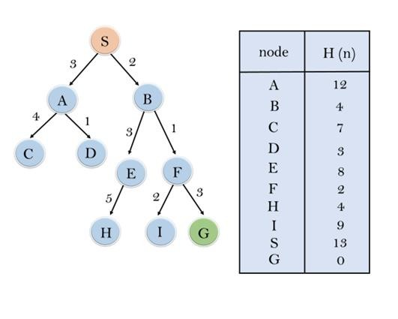
22AM2305

Slide 64
Best-first Search Algorithm (Greedy Search):
22AM2305
▶ Expand the nodes of S and put in the CLOSED list
▶ Initialization: Open [A, B], Closed [S]
▶ Iteration 1: Open [A], Closed [S, B]
▶ Iteration 2: Open [E, F, A], Closed [S, B]
: Open [E, A], Closed [S, B, F]
▶ Iteration 3: Open [I, G, E, A], Closed [S, B, F]
: Open [I, E, A], Closed [S, B, F, G]
▶ Hence the final solution path will be: S----> B----->F----> G
▶ Time Complexity: The worst case time complexity of Greedy best first search is O(b^{m}).
▶ Space Complexity: The worst case space complexity of Greedy best first search is O(b^{m}). Where, m is the maximum depth of the search space.
▶ Complete: Greedy best-first search is also incomplete, even if the given state space is finite.
▶ Optimal: Greedy best first search algorithm is not optimal.

Slide 65
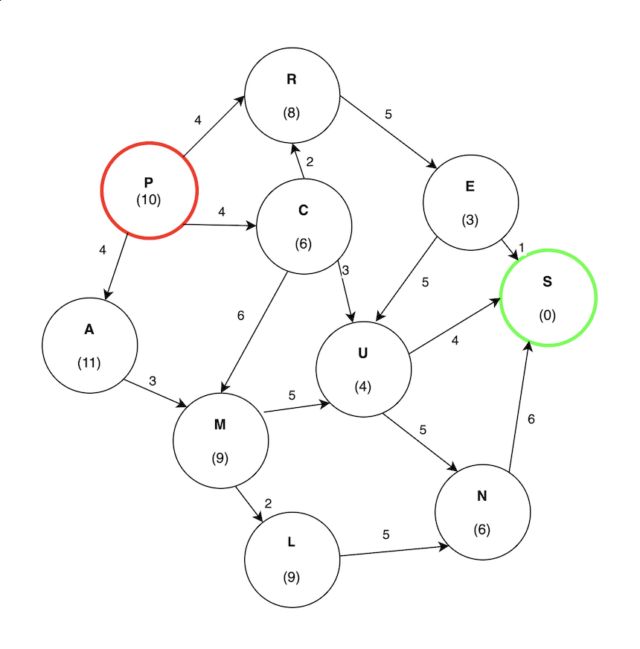
Example Consider finding the path from P to S in the following graph:
22AM2305

Slide 66
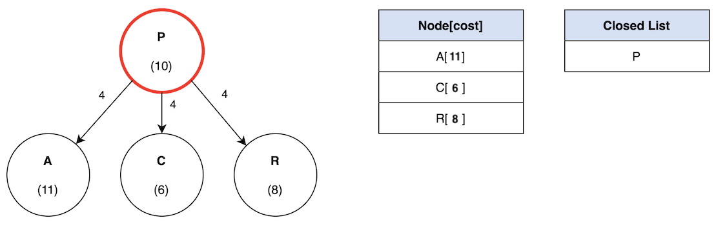
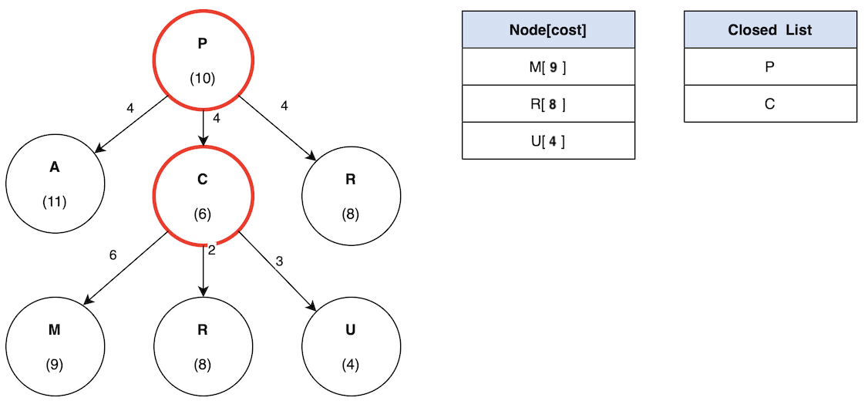
22AM2305
In this example, the cost is measured strictly using the heuristic value. In other words, how close it is to the target.
C has the lowest cost of 6. Therefore, the search will continue like so:

Slide 67
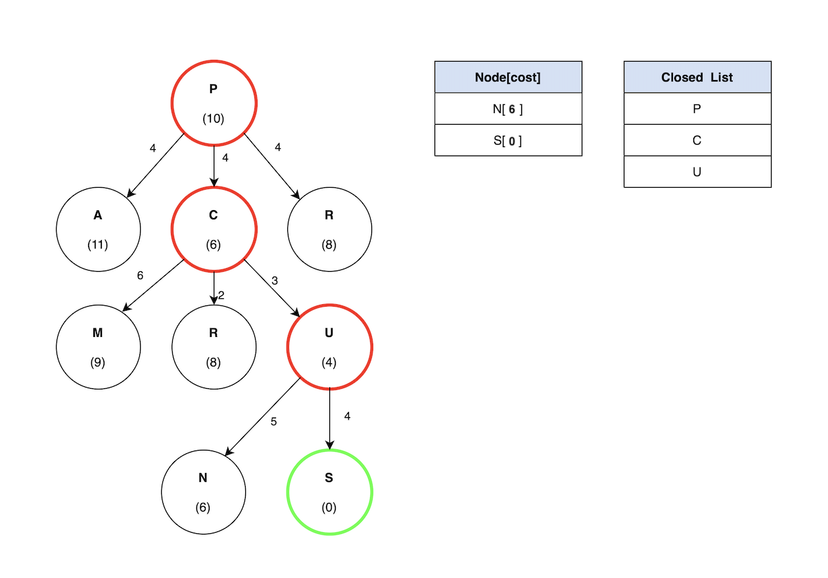
U has the lowest cost compared to M and R, so the search will continue by exploring U. Finally, S has a heuristic value of 0 since that is the target node:
22AM2305

Slide 68
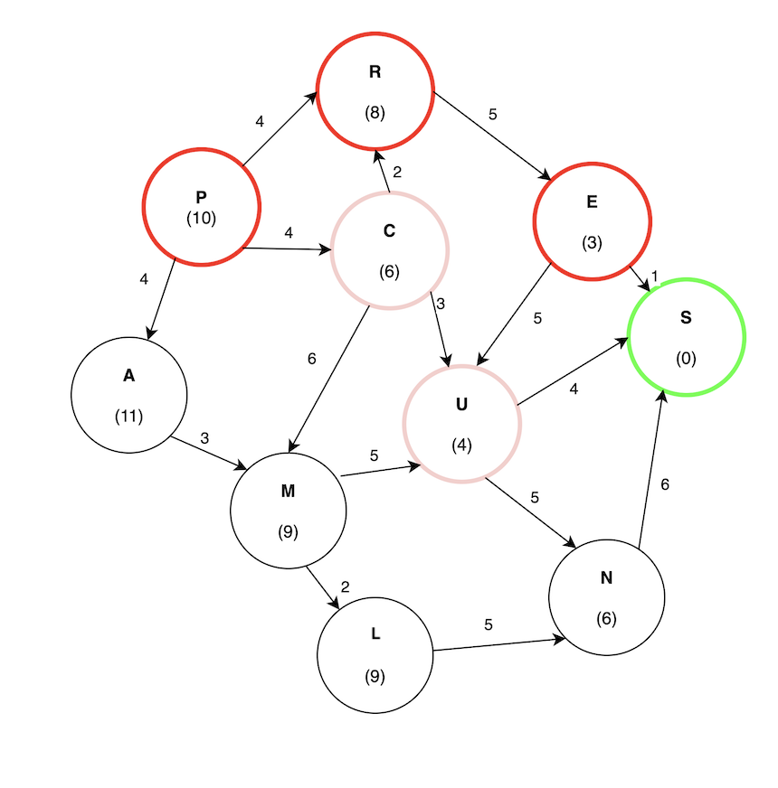
The total cost for the path (P -> C -> U -> S) evaluates to 10. The potential problem with a greedy best-first search is revealed by the path (P -> R -> E -> S) having a cost of 9, which is lower than (P -> C -> U -> S). Greedy best-first search ignored this path because it does not consider the edge weights.
22AM2305

Slide 69
Advantages of Greedy Best-First Search:
22AM2305
Simple and Easy to Implement: Greedy Best-First Search is a relatively straightforward algorithm, making it easy to implement.
Fast and Efficient: Greedy Best-First Search is a very fast algorithm, making it ideal for applications where speed is essential.
Low Memory Requirements: Greedy Best-First Search requires only a small amount of memory, making it suitable for applications with limited memory.
Flexible: Greedy Best-First Search can be adapted to different types of problems and can be easily extended to more complex problems.
Efficiency: If the heuristic function used in Greedy Best-First Search is good to estimate, how close a node is to the solution, this algorithm can be a very efficient and find a solution quickly, even in large search spaces.

Slide 70
Disadvantages of Greedy Best-First Search:
22AM2305
Inaccurate Results: Greedy Best-First Search is not always guaranteed to find the optimal solution, as it is only concerned with finding the most promising path.
Local Optima: Greedy Best-First Search can get stuck in local optima, meaning that the path chosen may not be the best possible path.
Heuristic Function: Greedy Best-First Search requires a heuristic function in order to work, which adds complexity to the algorithm.
Lack of Completeness: Greedy Best-First Search is not a complete algorithm, meaning it may not always find a solution if one is exists. This can happen if the algorithm gets stuck in a cycle or if the search space is a too much complex.

Slide 71
Applications of Greedy Best-First Search:
22AM2305
Pathfinding: Greedy Best-First Search is used to find the shortest path between two points in a graph. It is used in many applications such as video games, robotics, and navigation systems.
Machine Learning: Greedy Best-First Search can be used in machine learning algorithms to find the most promising path through a search space.
Optimization: Greedy Best-First Search can be used to optimize the parameters of a system in order to achieve the desired result.
Game AI: Greedy Best-First Search can be used in game AI to evaluate potential moves and chose the best one.
Navigation: Greedy Best-First Search can be use to navigate to find the shortest path between two locations.
Natural Language Processing: Greedy Best-First Search can be use in natural language processing tasks such as language translation or speech recognisation to generate the most likely sequence of words.
Image Processing: Greedy Best-First Search can be use in image processing to segment image into regions of intrest.

Slide 72
Assignment
22AM2305
Implement code for Depth-Limited Search and Greedy Search.
List the applications, advantages, and disadvantages of all the uninformed & and informed search techniques.

Slide 73
References
22AM2305
Text Book:
1. Artificial Intelligence, George F Luger, Sixth Edition, Pearson Education Publications, 2014.
Artificial Intelligence, Elaine Rich and Knight, McGraw-Hill Publications, 2010.
https://www.studocu.com/in/document/visvesvaraya-technological-university/artificial-intelligence/ai-unit-2-searching-techniques/39775680
https://iq.opengenus.org/depth-limited-search/#:~:text=Depth%20Limited%20Search%20is%20carried,goal%20node%20has%20been%20reached.

Slide 74

ME-1

